Slide 1
Project Suggestion
Tom

Slide 2
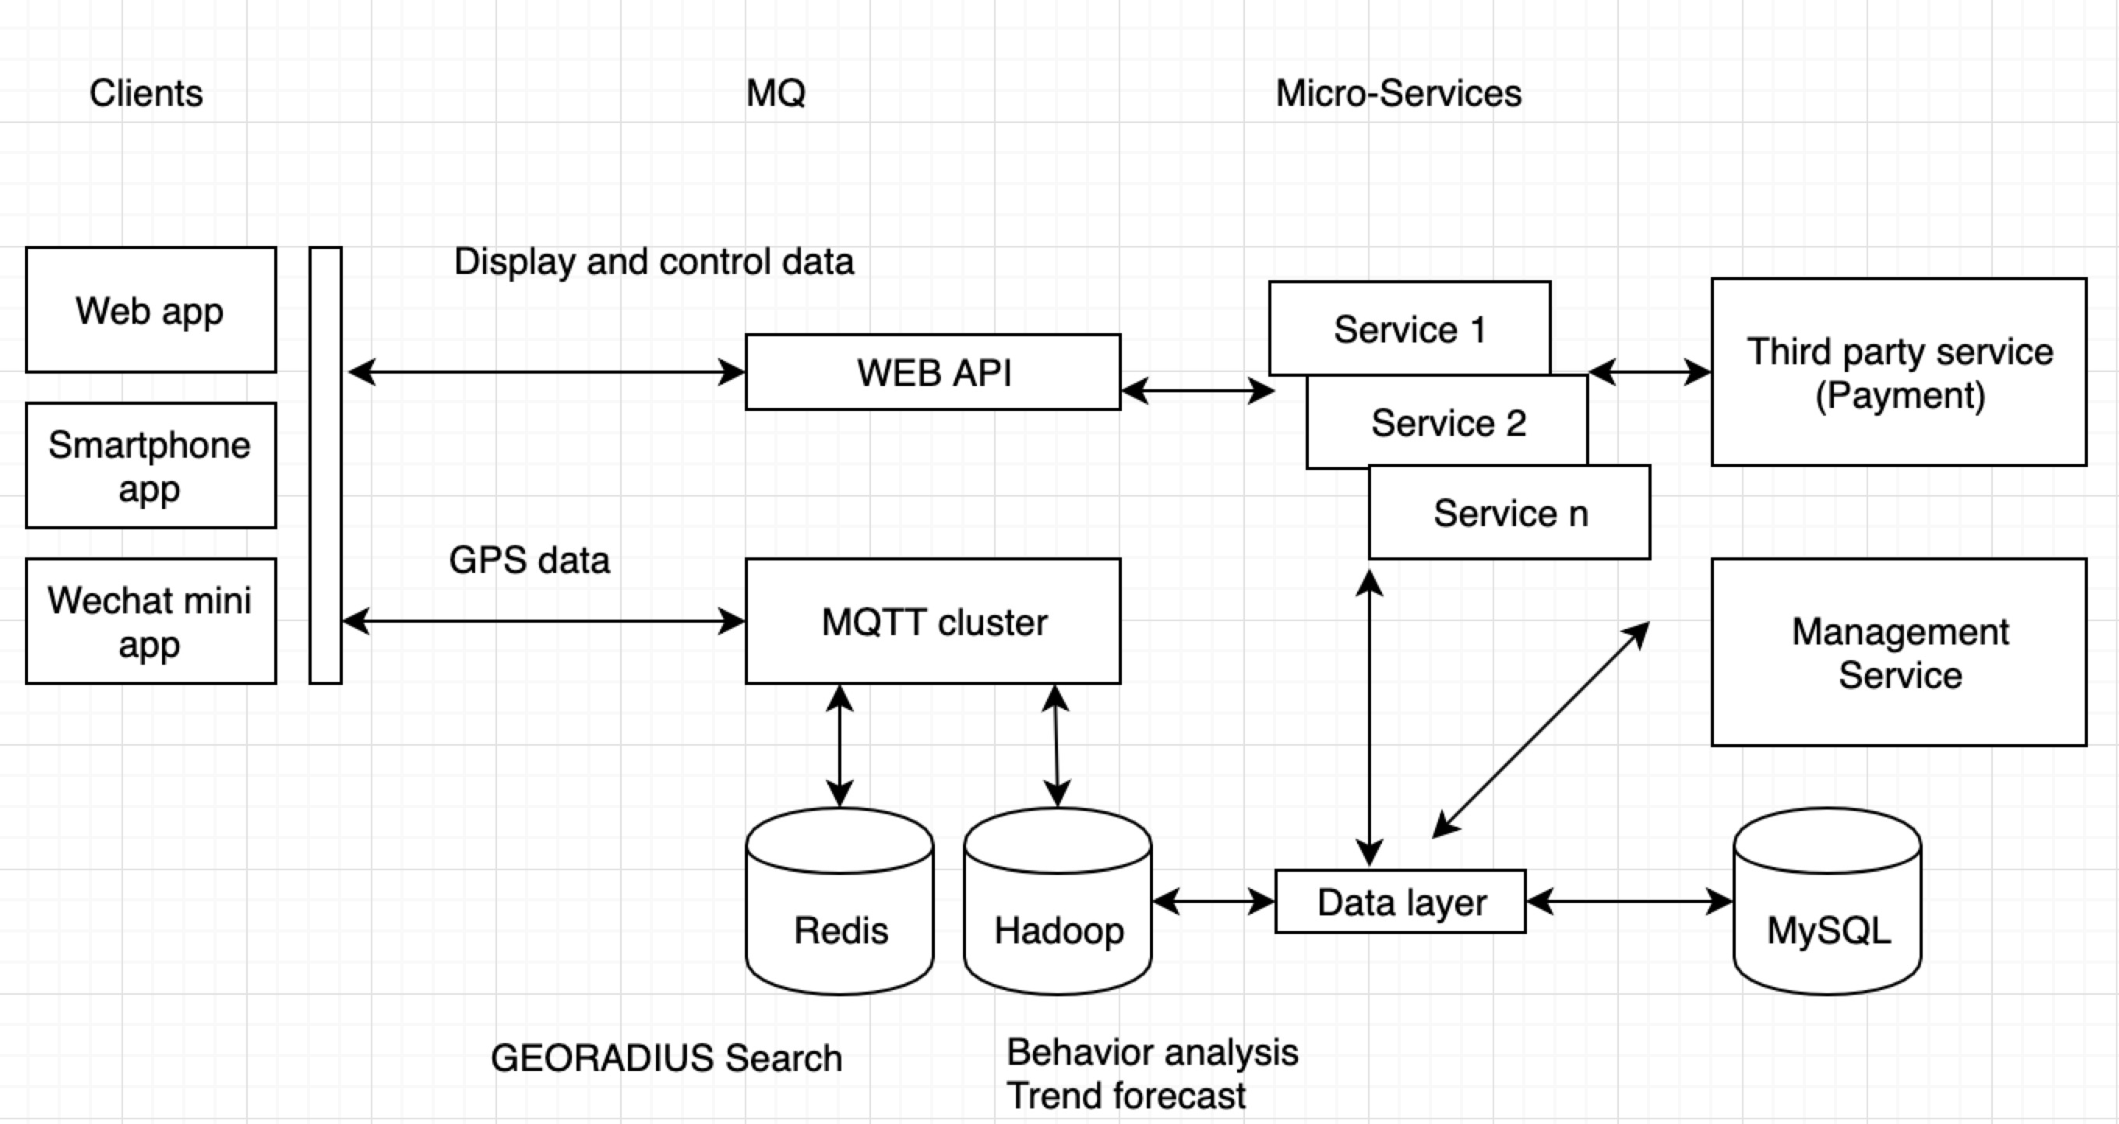
Architecture

Slide 3
Focus on Smartphone app
Native development method can make a high performance app,
But it is costly and time consuming.
So we recommend Cross-platform app development method.
And we recommend Google Flutter Cross-platform Framework, it is:
Nearly 90% of native application performance;
Cross-platform, rapid development;
Less maintenance costs.

Slide 4
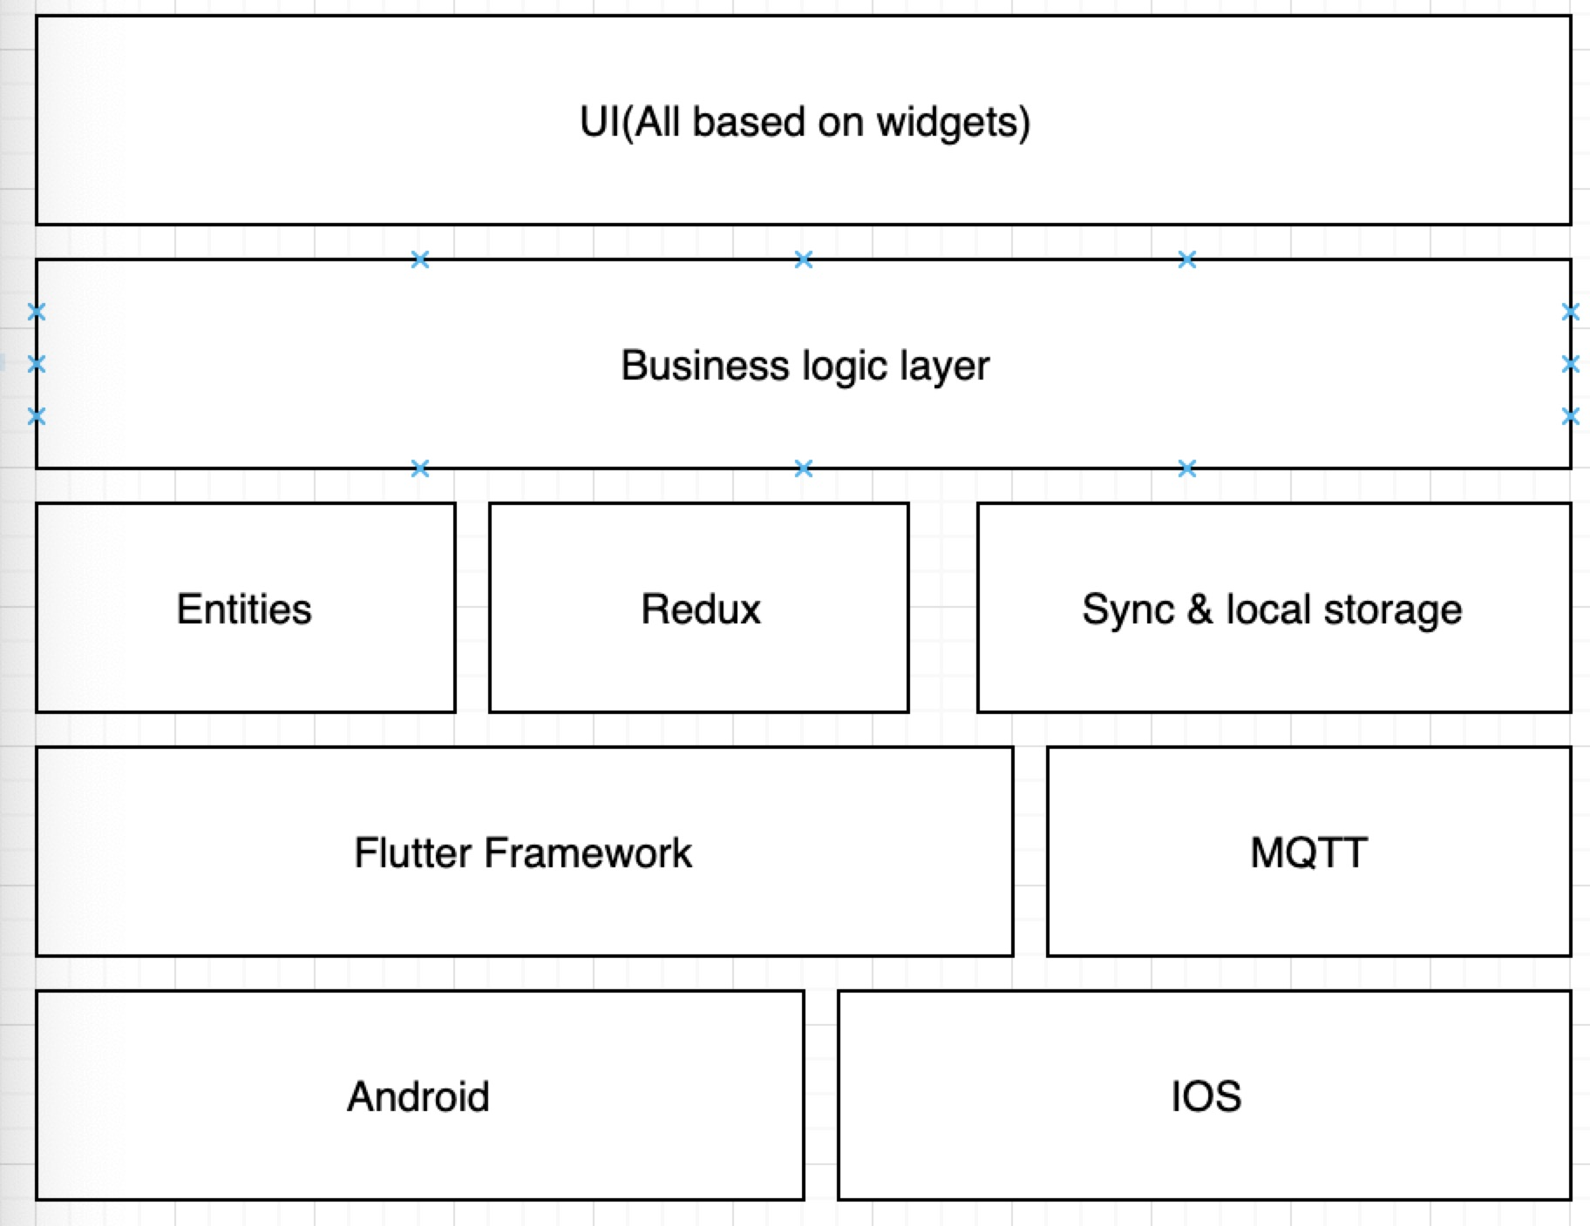
Smartphone app framework

Slide 5
Development team
A project manager(Act as product manager as well)
An UI/UE designer(Act as product manager as well)
Front-end developer(Flutter layouts and widgets)
Front-end developer(front-end logic layer and related components)
A Test Engineer(optional)
Back-end support Engineer(optional)

Slide 6
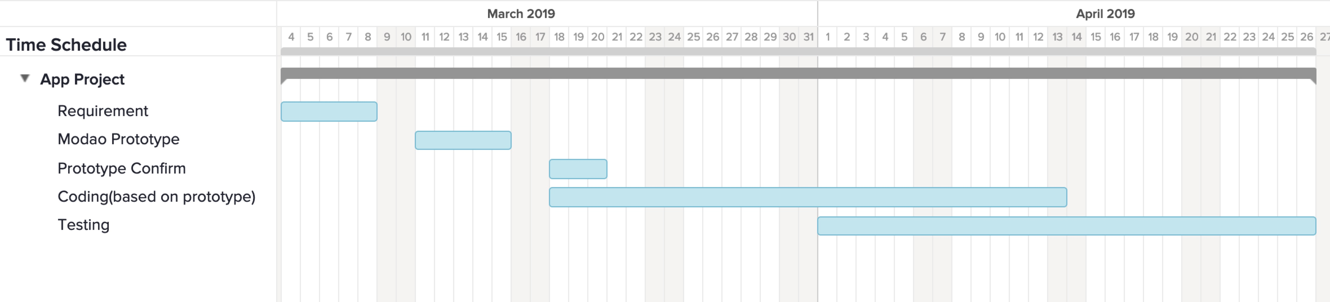
Time schedule sample

Slide 7
Tools
Github for:
source storage and control
Issues and bugs management
Worktile or slack for:
Project management

